Slide 1

E2 SPDA : Synergy and DOORS analysis Tool

Slide 2
Objective of the Tool
Identifies the gaps between Synergy artefacts and DOORS
Helps in traceability mismatches in DOORS as compared to Synergy Artefacts
Helps in improving the quality of test artifacts which are escaped through oversight
Identifies the missing files in Synergy compared to DOORS attributes
Helps in reducing the Certification risks
Reduces the human efforts up to 80%
Navigates to the actual mismatches as the generated report indicates which are all are of mismatches
Notes:
Pradeep / Ajay – Update MFA

Slide 3

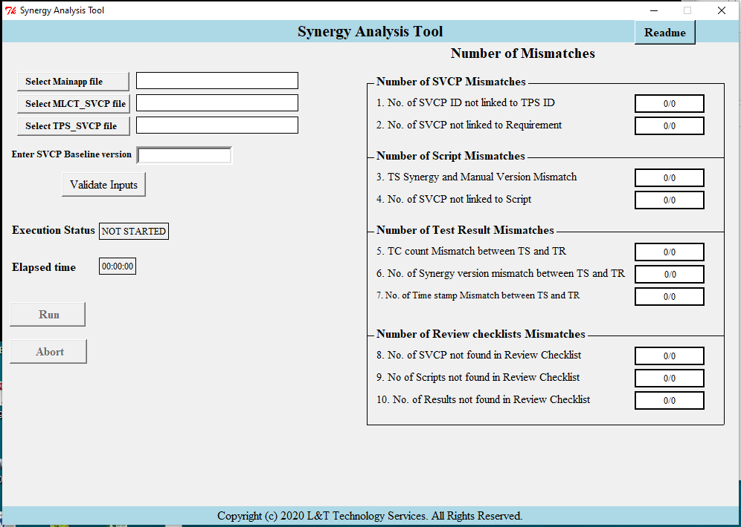
Flow Chart
Synergy and DOORS analysis Tool
DOORS extract
Spreadsheet(s)(*.xls)
Main app SVCP
Module SVCP
TPS SVCP
Analysis Tool
Generates raw report
on mismatches
(*.xls)
Synergy dump files
Test cases
Test scripts
Test results
Checklists…

Slide 4
Procedure to run the Tool
Extract Main app software SVCP (Software Verification Cases and Procedures) from doors with the following attribute
ID
DS10793/327
In-links at depth 1
Out-links at depth 1
Out-links at depth 2
Extract Module SVCP from doors with the following attribute
ID
DS10793/327 - E2 SPDA Software Verification Cases and Procedures
In-links at depth 1
In-links at depth 2
Out-links at depth 1
Out-links at depth 2
Extract TPS SVCP surrogate from doors with following attribute
ID
In-links at depth 1
Out-links at depth 1
Select above 3 input .xlsx files in Tools GUI
Enter the Main app SVCP baseline version
Click Validate Inputs button
Once validation passed 'Run' button will be enabled
Click 'run' button and give the synergy dump path.
Wait for the execution to complete
'error log' file contains the errors which are all occurs while executing the tool.
'Output file' file contain verification matrix and path will be provided in the GUI bottom.
Convert this into Flow chart- Slide#3

Slide 5
Main Screen
User Interface of the Tool
Tool uses the DOORS and Synergy artefacts and generate the reports on below gaps
SVCP Mismatches-
SVCP ID’s not linked to TPS ID’s
SVCP not linked to Requirements
Script Mismatches-
Mismatch between Synergy version and Manual versions
SVCP ID not linked to Scripts
Test Result Mismatches-
Test Case count mismatch between scripts and results
Version mismatch between scripts and results
Time stamp mismatch between scripts and results
Review checklists Mismatches-
SVCP not found in review checklists
Scripts not found in review checklists
Results not found in review checklists
Notes:
Pradeep / Ajay – Update MFA

Slide 6
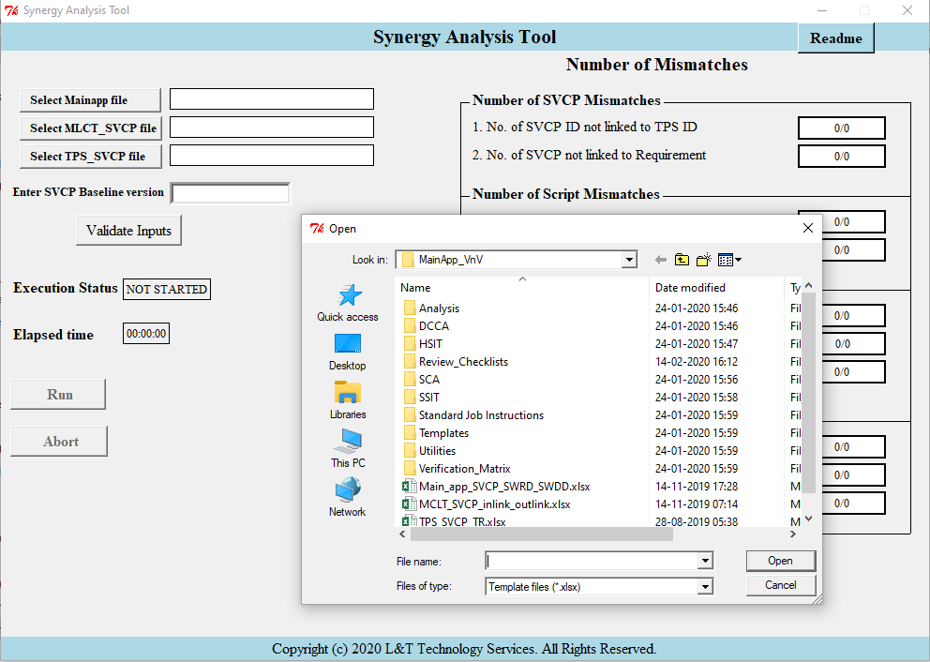
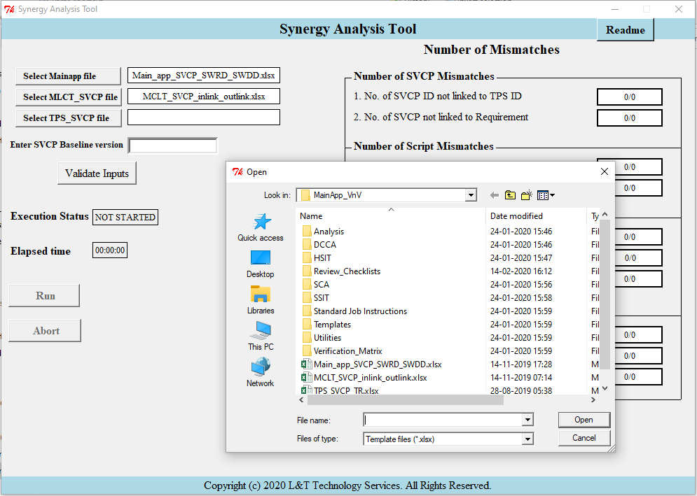
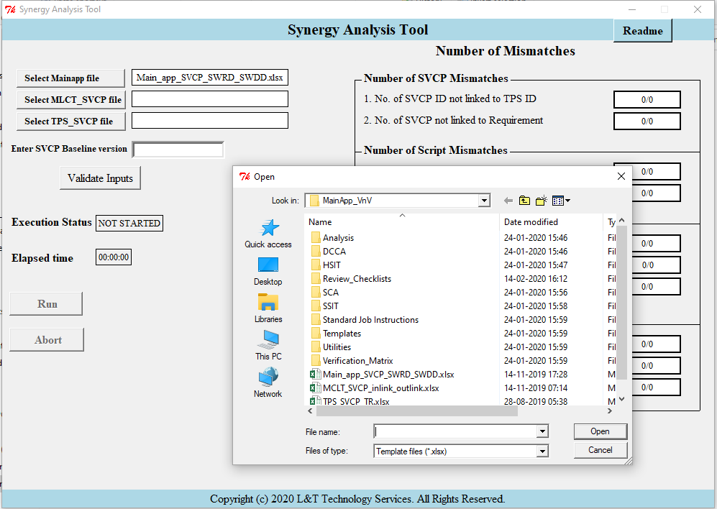
Tool Demo – Selecting the input files from DOORS
Step1: select Main App software SVCP from doors with the specified attributes mentioned in slide #4
Step2: select Module SVCP from doors with the specified attributes mentioned in slide #4
Step3: select TPS SVCP from doors with the specified attributes mentioned in slide #4

Slide 7
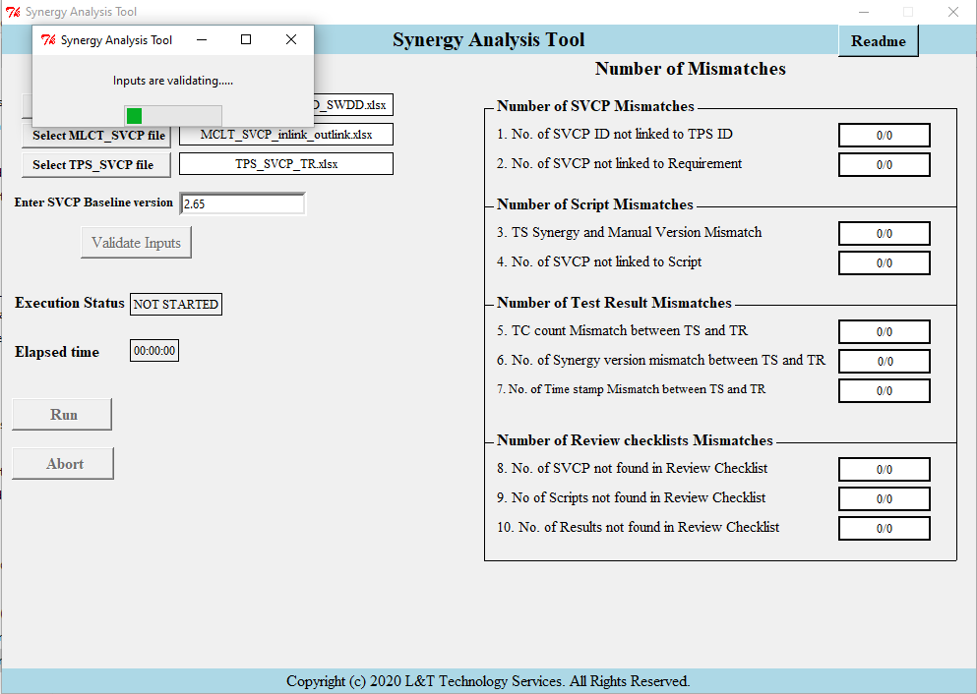
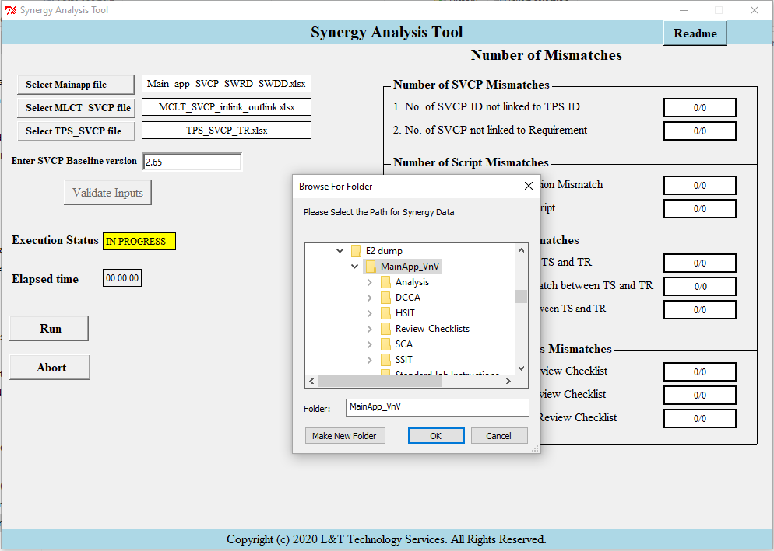
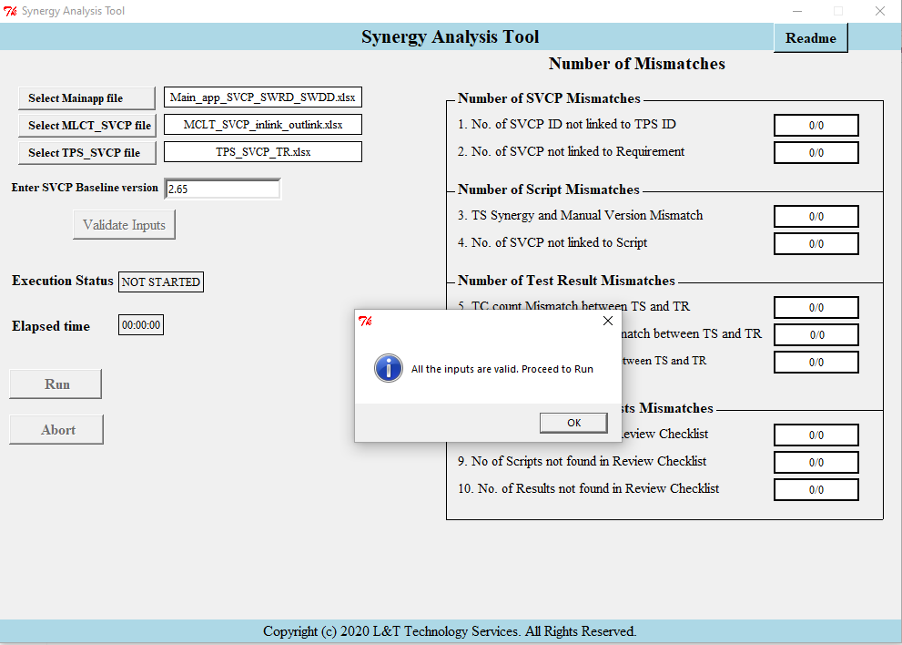
Tool Demo – Validating and selecting the synergy local path
Step 4: Enter SVCP basline version and press “Validate inputs”
Step 5: If inputs are valid it will direct to press “Run” Button
Step 6: Upon pressing “Run” button specify the synergy dump path in the pop-up window
Fig - 5

Slide 8
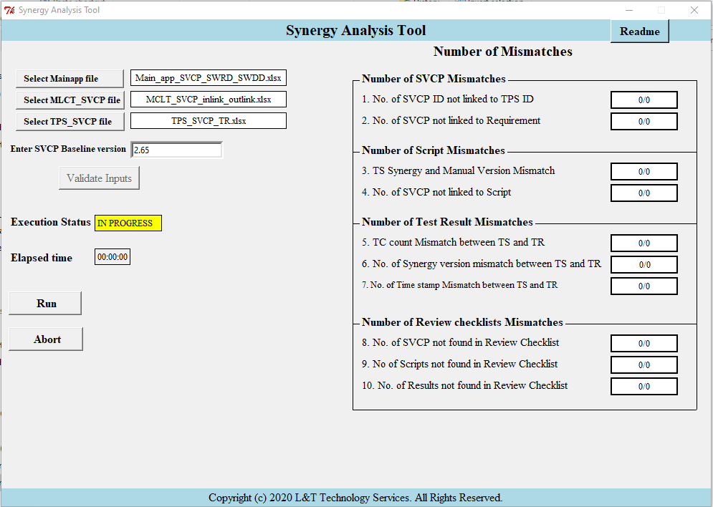
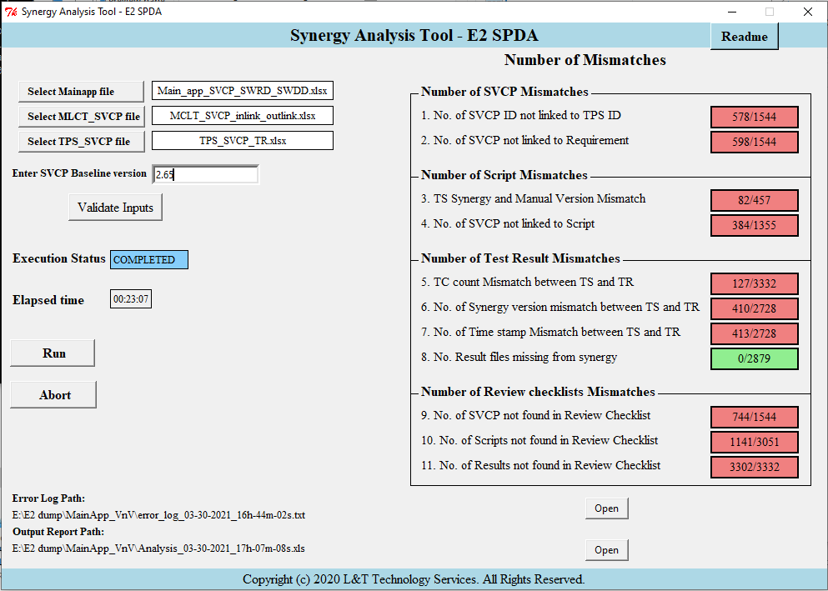
Tool Demo – Execution status and Report
Step 7: once the synergy path is selected execution status turns Yellow indicating “IN PROGRESS”
Step 8: Upon completion, GUI shows the no of mismatches
Generated Report

Slide 9
Thank you

